Slide 1
Correlated genotypes across Homo sapiens genome

Slide 2
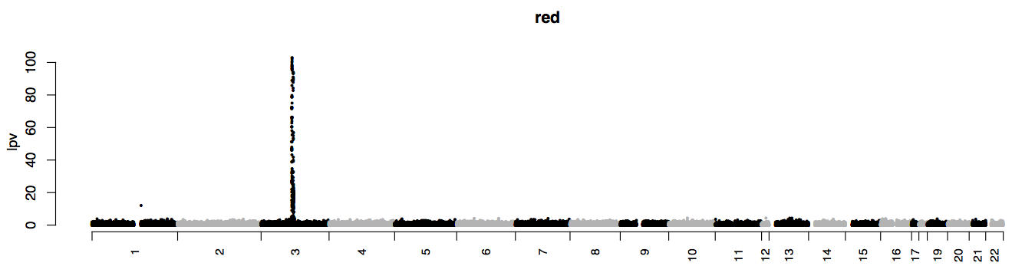
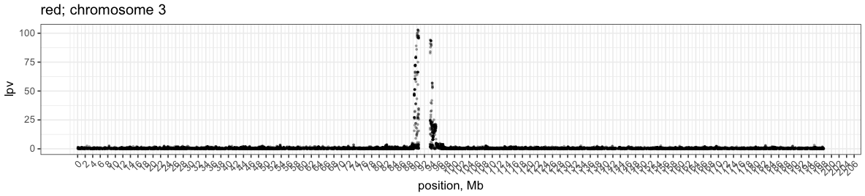
Correlated genotypes across Homo sapiens genome
peri-centromeric mega haplotypes

Slide 3
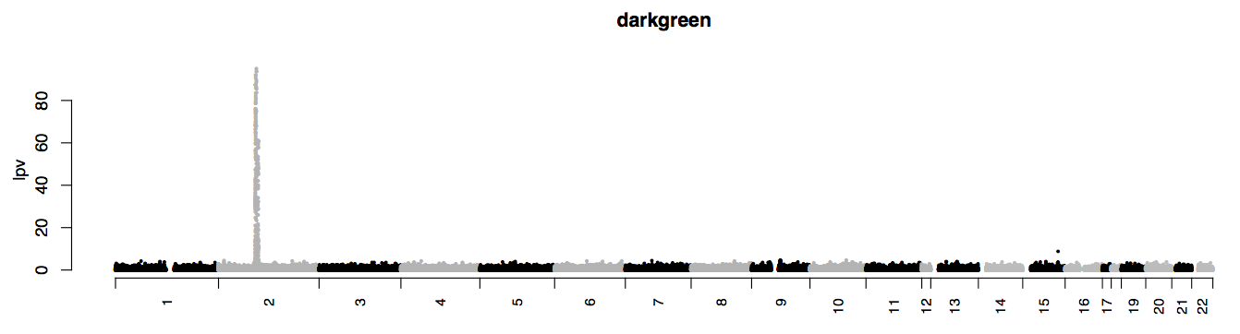
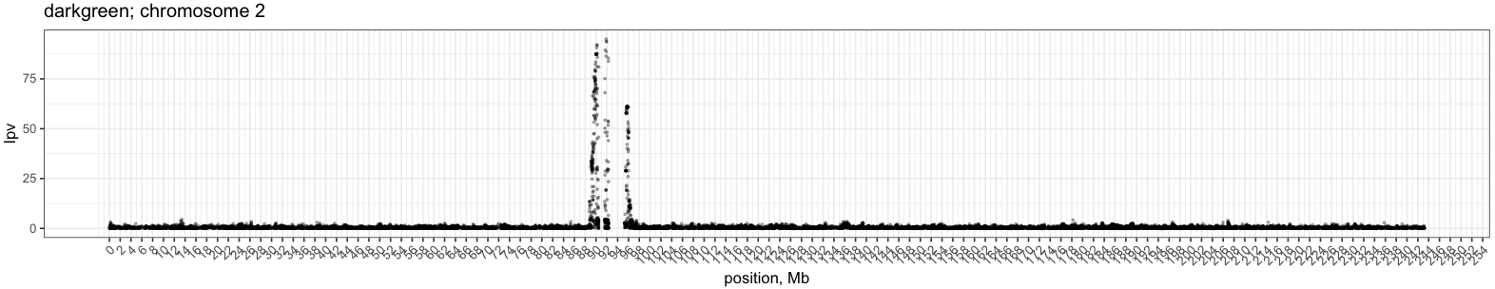
Correlated genotypes across Homo sapiens genome
peri-centromeric mega haplotypes
- peri-centromeric mega haplotypes

Slide 4
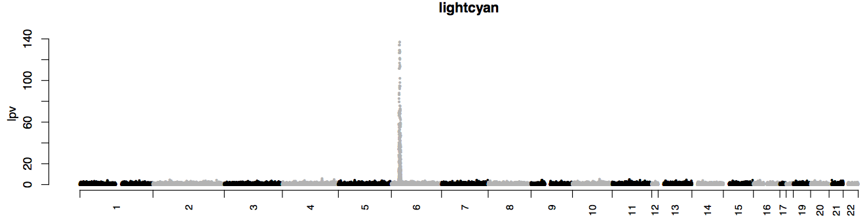
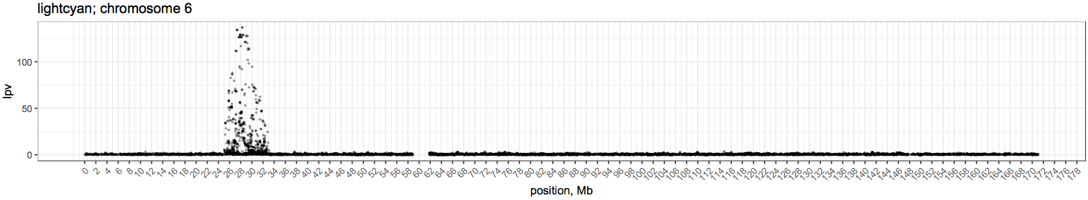
Correlated genotypes across Homo sapiens genome
mega haplotypes –
MHC locus

Slide 5
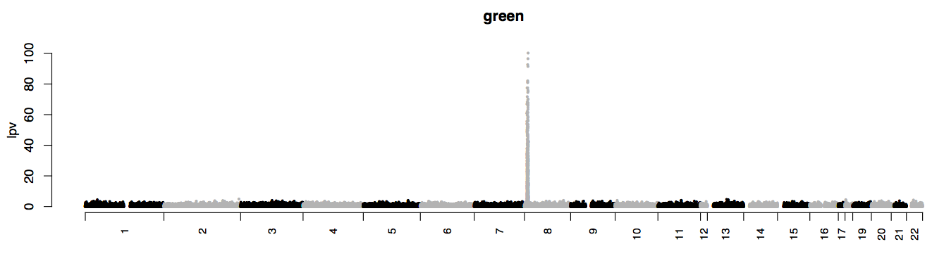
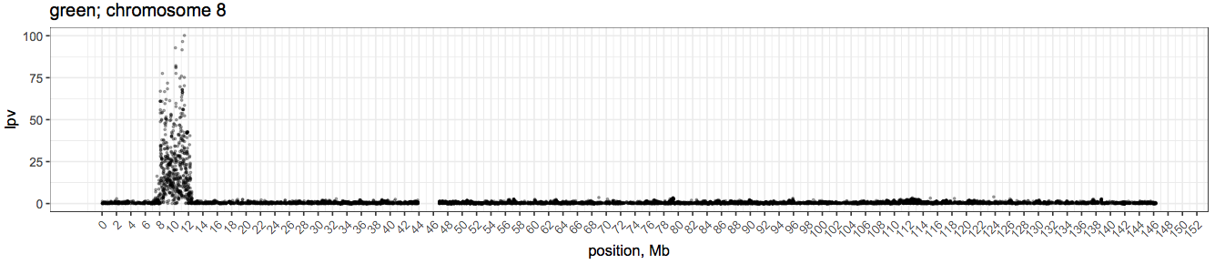
Correlated genotypes across Homo sapiens genome
mega haplotypes –
?

Slide 6
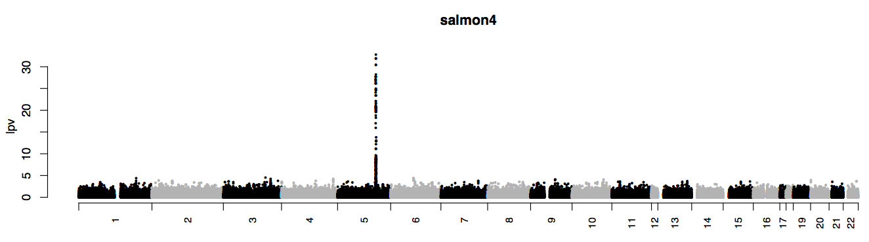
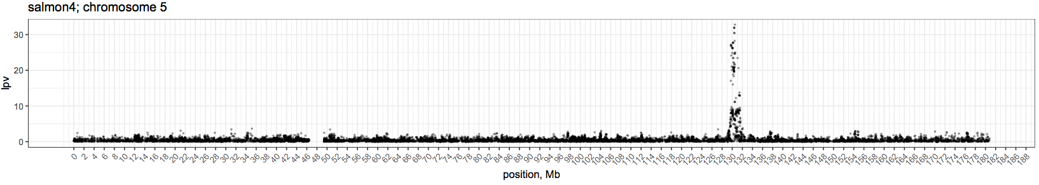
Correlated genotypes across Homo sapiens genome
mega haplotypes –
?

Slide 7
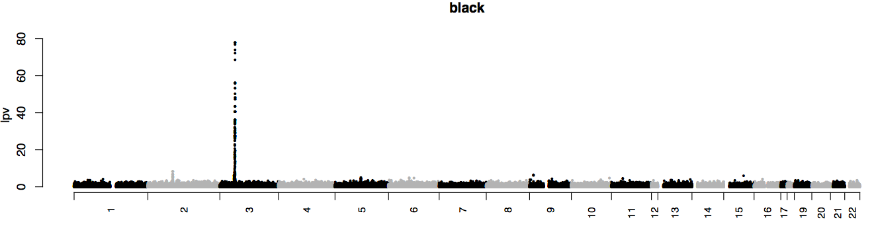
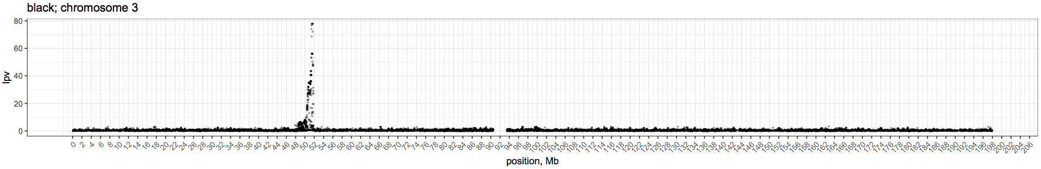
Correlated genotypes across Homo sapiens genome
mega haplotypes –
?

Slide 8
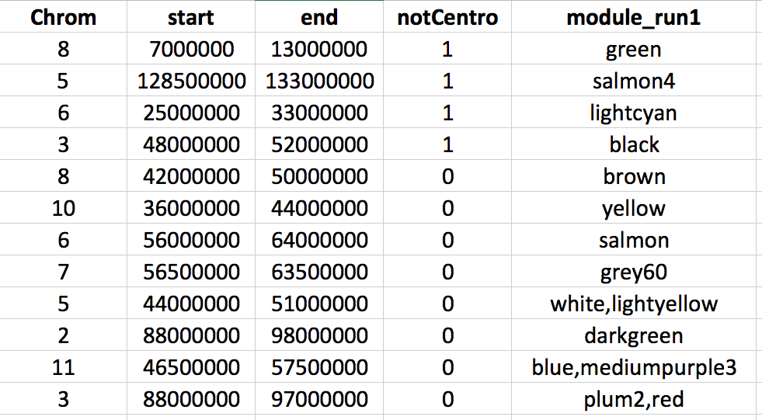

Slide 9
Correlated genotypes across A.millepora genome

